Slide 2
Anthrop:man;mankind
Phil: love
Miso: hate
Biblio,bibl: book
Phon: sound
Graph,Gram:write; draw; describe; record
scop, scept, skept:look at; examine

Slide 3
CLimax
Definition: The highest or most intense point in a story.
In order to find the climax of the story, make sure you look for the outcome of the story. CLimax usually comes before the outcome of the story, so once you find the turning point look back.

Slide 4
Supporting Details
Supporting Details are what come after the topic sentence and make up a paragraph. They also develop, explain, and support the main idea.

Slide 5
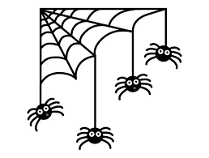
a figure of speech that makes a comparison, showing similarities between two different things
Uses “like” or “As”

Slide 6
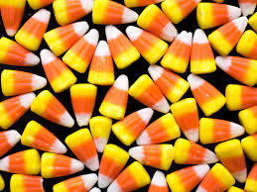
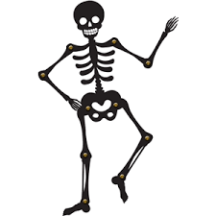
Author's Purpose
There are three types to author's purpose
To Persuade - to convince the audience
Ex: A ad for clothing or accessories
To Inform- to give information about something
Ex: a newspaper about the dustball
To entertain - to make the audience seem amused
Ex: any type of short story like The Monkey's Paw

