Slide 1
The Odyssey
Book 10: Circe, the Grace of the Witch
Book 11: The Land of the Dead

Slide 2
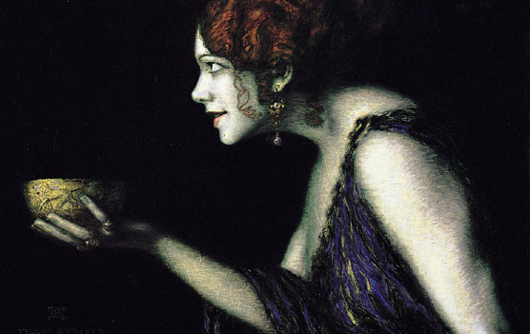
Book 10: Circe, the Grace of the Witch

Slide 3
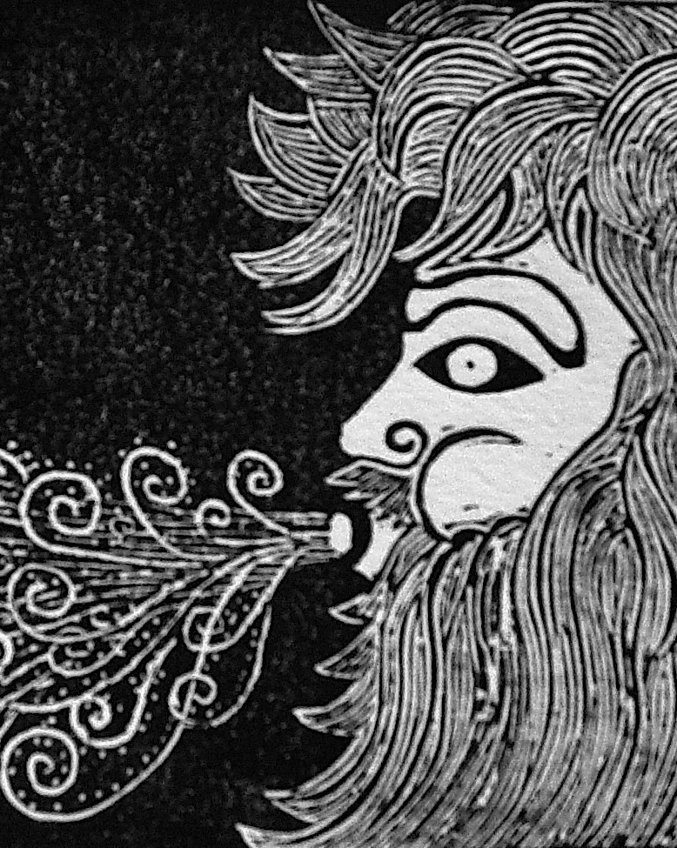
Aeolus, the Wind God
Spent 1 month on his island
2 gifts:
A fair wind to blow them toward Ithaca
A bag of stormy winds
Odysseus’s men open the bag while he’s sleeping.
Aeolus refuses to help again, believing their trip is cursed by the gods.

Slide 4
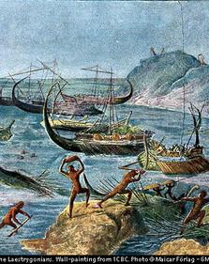
The Laestrygones
Laestrygones are giant, boulder-throwing cannibals.
Only Odysseus & the men on his own ship survive the attack; they sail to Aeaea, home of Circe.

Slide 5
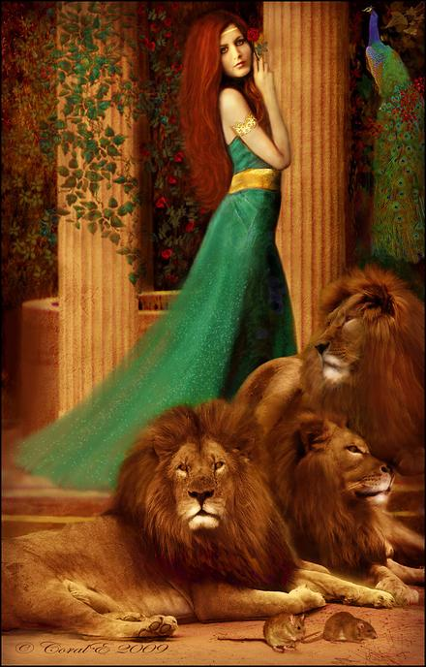
Circe, the Witch
Eurylochus takes half of Odysseus’ men to explore the island.
When they find Circe, the courtyard outside her house is filled with mountain lions, and wolves.
All but Eurylochus entered her house because he felt it was a trap.

Slide 6
Circe gave Odysseus’ men food & drink that she made specially for them and then turned them into pigs.
Eurylochus runs back to the ship to explain what has happened; he begs Odysseus to leave.
On his way to save his men, Odysseus is intercepted by Hermes who gives him moly to protect him from Circe’s power & tells Odysseus he must make her promise no “witches’ tricks.”
Circe turns Odysseus’ men back, but puts them in a trance.
They stay for 1 year until Odysseus begs to leave, and she tells him he must go to the Land of the Dead and hear a prophecy from the ghost of Tiresias.

Slide 7
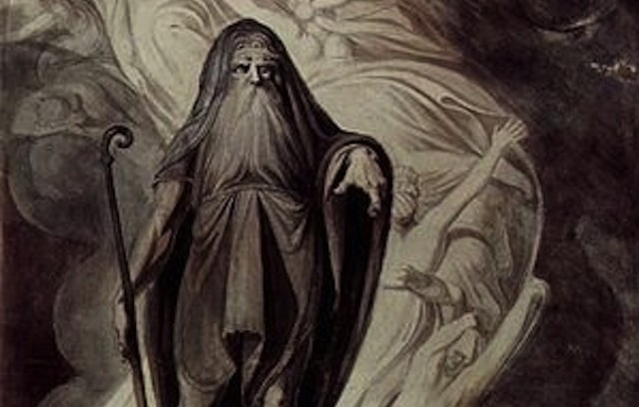
Book 11: The Land of the Dead

Slide 8
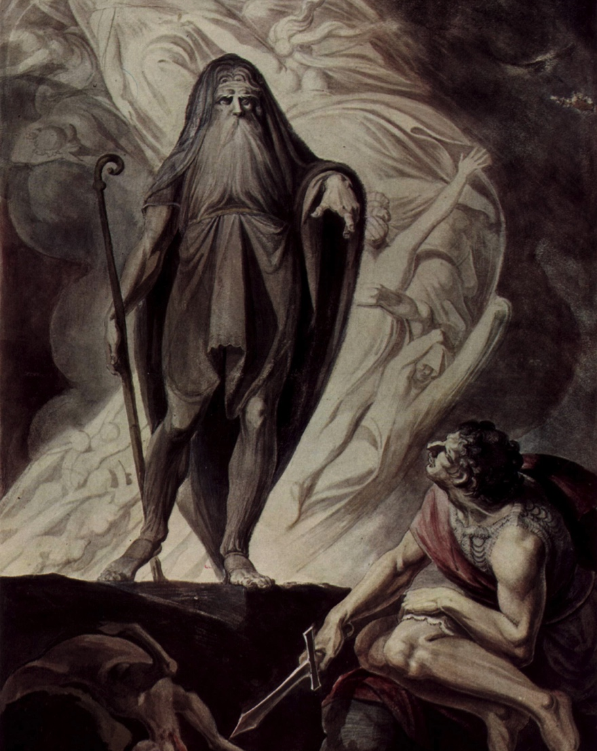
In the Land of the Dead, Odysseus encounters 3 ghosts:
Elpenor: one of Odysseus’ men who died on Circe’s island; he asks Odysseus to have a funeral for him.

Slide 9
Tiresias prophesies over Odysseus:
Your journey has been made difficult by Poseidon because of what you did to his son, Polyphemus.
When you get to Thrinacia, avoid Lord Helios’ cattle; your crew will be destroyed if they do not leave them alone.
You, alone, will return to Ithaca, but it is overrun with suitors after your wife and throne.
Make a sacrifice to Poseidon afterwards, and you will have a soft, peaceful death.
Anticlea:
Tells Odysseus his wife, child, and father still mourn him.
Explains that she died of a broken heart while Odysseus was away.

