Slide 2
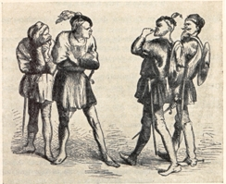
Timeline: Sunday
Act I Scene i – Morning – line 151 “But new struck nine.”
Montagues and Capulets fight in the streets and are broken up by Prince Escalus.
Romeo pines for Rosaline.
Act I Scene ii – Afternoon – line 58 “God 'i' good e'en. I pray, sir, can you read?”
Lord Capulet and Paris talk about arranging a marriage to Juliet.
Romeo and Benvolio learn that Rosaline has been invited to a party at the Capulet house. Benvolio suggests crashing the party so that Romeo can see that the other women are more beautiful than Rosaline is.
Act I Scene iii – Evening – line 102 “Madam, the guests are come, supper served up,”
Lady Capulet tells Juliet that Paris wants to marry her.”

Slide 3
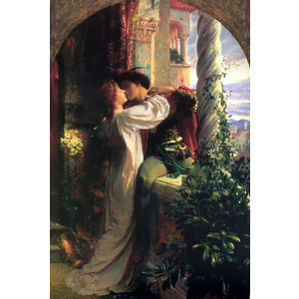
Timeline: Sunday Cont.
Act I Scene iv – Evening – line 11 “Give me a torch. I am not for this ambling.”
Romeo and friends arrive outside the Capulet house.
Act I Scene v – Evening/late evening – line 124 “I thank you, honest gentlemen. Good night.—”
Romeo and Juliet meet at the party and fall in love.
Tybalt is angry that Romeo came.
Act II Scene i – Late evening
Romeo looks for Juliet.
Benvolio and Mercutio look for Romeo.
Act II Scene ii – Latr evening 171 “By the hour of nine.
The famous balcony scene: Romeo and Juliet decide that they will get married the next morning.

Slide 4
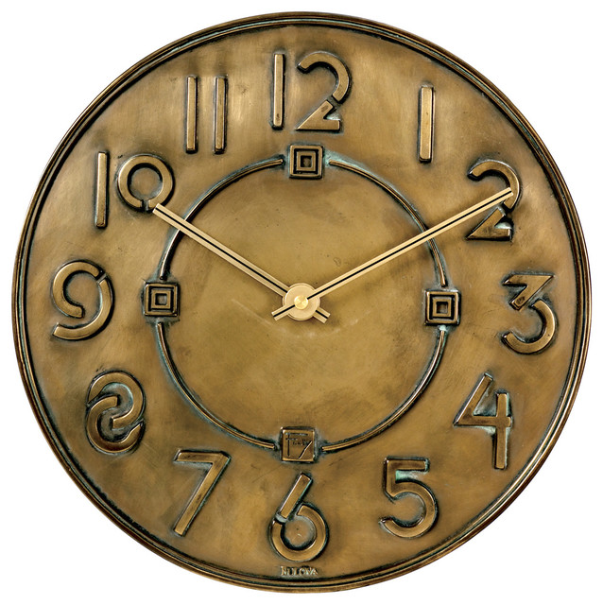
Timeline: Monday
Act II Scene iii – Early morning – line 1 “The gray-eyed morn smiles on the frowning night,”
Romeo goes to Friar Laurence to arrange the wedding.
Act II Scene iv – Noon – line 57 "the dial is now upon the prick of noon".
Tybalt is planning to challenge Romeo to a duel. Romeo finds them.
The Nurse warns Romeo that he better not be toying with Juliet because Paris genuinely wants to marry her.
Act II Scene v – Afternoon – line 10-11 “Of this day’s journey, and from nine till twelve Is three long hours, yet she is not come.”
Juliet is upset that the Nurse is taking so long.
The Nurse delivers Romeo's message.
Act II Scene vi – Afternoon
Romeo and Juliet meet at Friar Laurence's cell and get married.

Slide 5
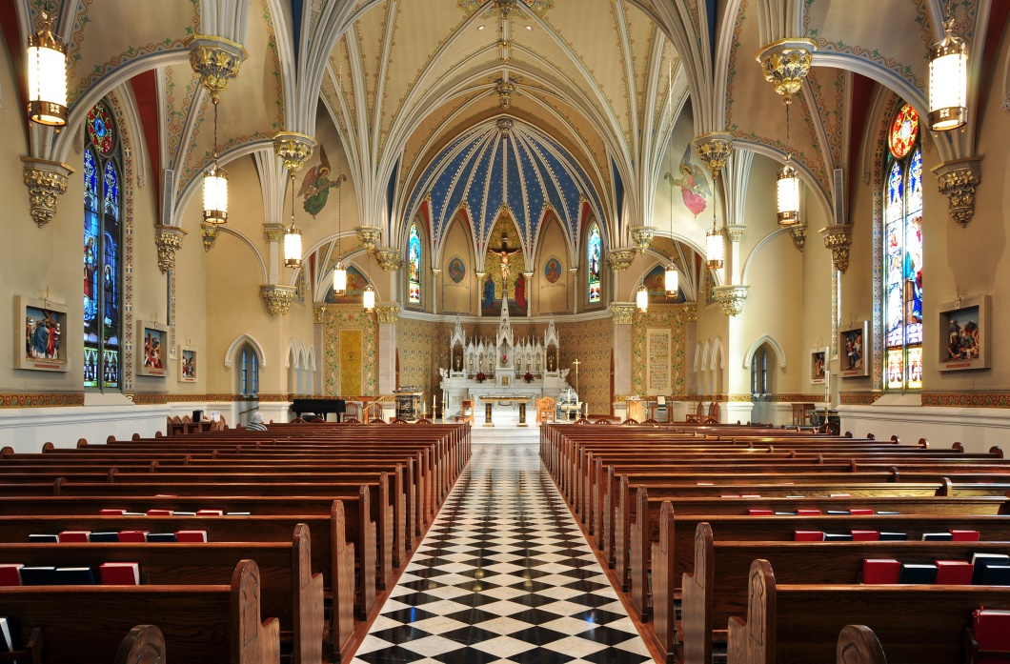
Timeline: Monday Cont.
Act III Scene i – Afternoon
Benvolio and Mercutio encounter Tybalt. Romeo arrives, and Tybalt challenges him. Romeo refuses, so Mercutio fights Tybalt. Tybalt kills Mercutio, so Romeo kills Tybalt. The Prince orders that Romeo be banished.
Act III Scene ii – Late Afternoon – line 101 “When I, thy three hours' wife, have mangled it?”
Juliet yearns for night to fall so that Romeo will be able to come.
The Nurse tells her about Tybalt's death and Romeo's banishment.
Act III Scene iii – Late Afternoon
Friar Laurence tells Romeo that he has been banished. The Nurse comes to bring Romeo to Juliet.
Act III Scene iv – Late Afternoon – “'Tis very late. She’ll not come down tonight.”
Lord Capulet decides that Juliet shall marry Paris on Thursday.

Slide 6
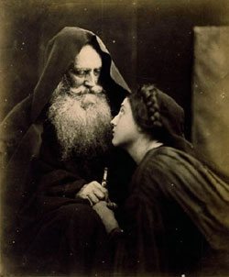
Timeline: Tuesday
Act III Scene v – Early Morning – Lines 1-35, 112, 153, 161, 191
Romeo leaves for Mantua after spending the night with Juliet.
Juliet is told that she must marry Paris on Thursday morning - or else.
Act IV Scene i – Late morn/afternoon – line “Or shall I come to you at evening mass?”
Paris talks to Friar Laurence about the upcoming wedding.
Juliet goes to Friar Laurence, and he suggests a plan that she take a drug that will make her look dead so that she can sneak away with Romeo.
Friar Laurence sends Friar John to Mantua with a message for Romeo.

Slide 7
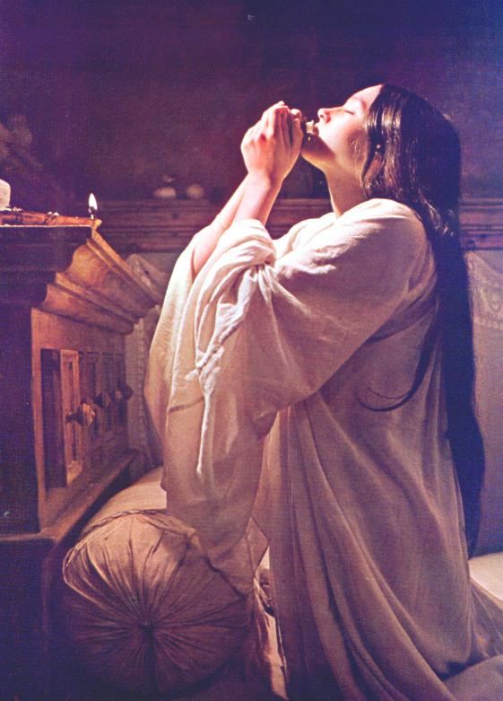
Timeline: Tuesday Cont.
Act IV ii – Early evening – Line 37 “'Tis now near night.” 22 “I’ll have this knot knit up tomorrow morning.”
Lord Capulet is arranging a big wedding celebration.
Juliet returns from seeing Friar Laurence and pretends to be cooperating.
Lord Capulet moves wedding to Wednesday.
Act IV iii – Evening – line 40 “I’ll not to bed tonight. Let me alone.”
Juliet drinks the drug.
Juliet is taking the drug a day early which means that the information in Friar Laurence's letter to Romeo is now wrong. Uh oh!

Slide 8
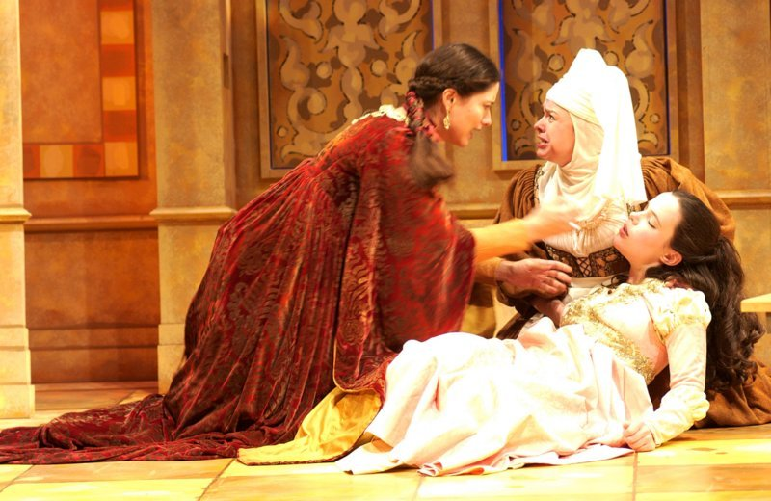
Timeline: Wednesday
Act IV Scene iv – Tuesday late through Wednesday early morn – line 4 “The curfew bell hath rung, 'tis three o'clock”
Lord Capulet supervises the wedding preparations throughout the night. Paris arrives very early in the morning, which was the custom at the time.
Act IV Scene v – Morning
The Capulets and the others discover Juliet's "dead" body.

Slide 9
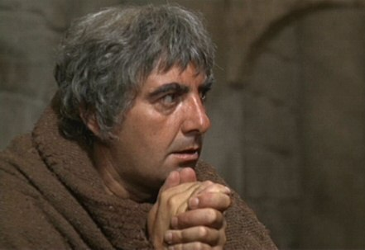
Timeline: Thursday
Act V Scene i
Romeo speaks about a dream he had.
In Mantua, Romeo learns from Balthasar that Juliet is dead.
Romeo buys poison from the Apothecary.
Act V Scene ii – Evening – line 25 “Within this three hours will fair Juliet wake.” If Juliet took the drug late Tuesday night, and it lasts for forty-two hours, it must now be early Thursday evening.
Friar Laurence learns that Friar John was unable to deliver the message to Romeo.
Friar Laurence writes another letter to Romeo and leaves for the crypt to meet Juliet when she wakes.
Notes:
http://robertspage.com/romeo.html

Slide 10
Timeline: Thursday Cont.
Act V Scene iii – Late evening Thursday through Early Friday – lines 15, 190, 204-204, 321
Paris and a servant arrive at Juliet's tomb.
Romeo gives Balthasar his suicide note and sends him away.
Paris confronts Romeo, and Romeo kills him.
Romeo kills himself.
Friar Laurence meets Balthasar and finds the bodies.
Juliet wakes up and flees from Friar Laurence. Juliet kills herself.
Watchmen find the bodies and send for the Prince, Capulets, and Montagues.
Balthasar and Friar Laurence are apprehended.
The Prince, Capulets, Montagues, and others arrive.
Lady Montague has died of grief.
Friar Laurence, Balthasar, and the servant explain what happened.
The Prince scolds Lord Capulet and Lord Montague, who finally end their feud.

